Slide 1
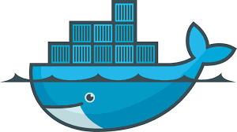
Docker

Slide 2
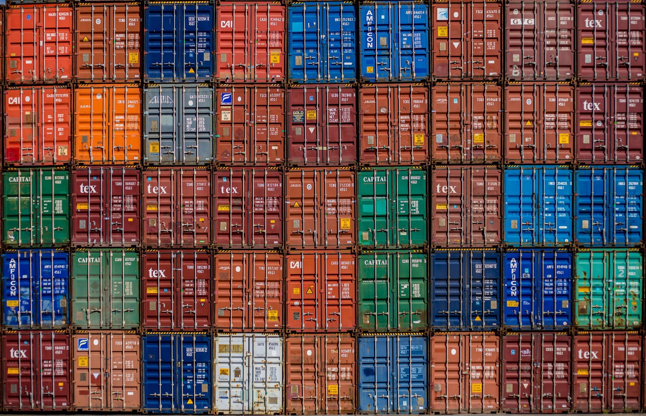

Slide 3
What is container?
Docker is a platform for developing, shipping and running applications using container virtualization technology. The Docker Platform consists of multiple tools.
Docker is an open-source project that automates the deployment of applications inside software containers, by providing an additional layer of abstraction and automation of operating-system-level virtualization on Linux, Mac OS and Windows.

Slide 4
MORE INFO
Container based virtualization uses the kernel on the host's operating system to run multiple guest instances
Each guest instance is called a container
Each container has its own
Root filesystem
Processes
Memory
Network ports

Slide 5
Problem
slow deployment
timesHuge
costsWasted
resourcesDifficult to scale or migrate
Vendor lock in

Slide 6
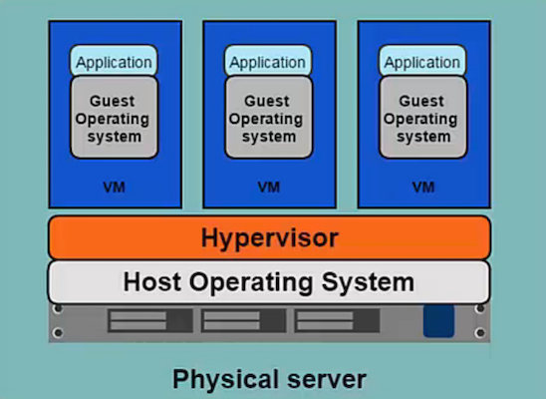
Hypervisors based virtualization

Slide 7
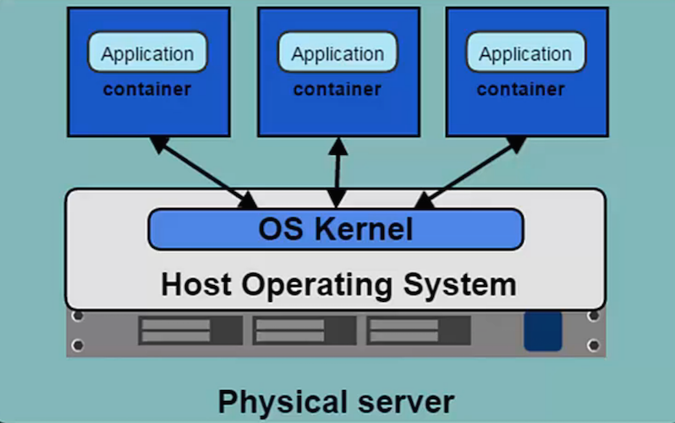
CONTAINER ARCHI

Slide 8
BENEFIT
Better resource poolingone
physical machine divided into multiple VM
Easier to scale
VM's in the cloud
Pay as you go

Slide 9
LIMITATATION
Each VM stills requires
CPU allocation
storage
RAM
An entire guest operation system
More VM's you run, the more resources you need
Guest OS means wasted resources

Slide 10
CONTAINER Vs VM
Containers are more lightweight
No need to install guest OS
Less CPU, RAM, storage space required
More containers per machine than VMs
Greater portability

Slide 11
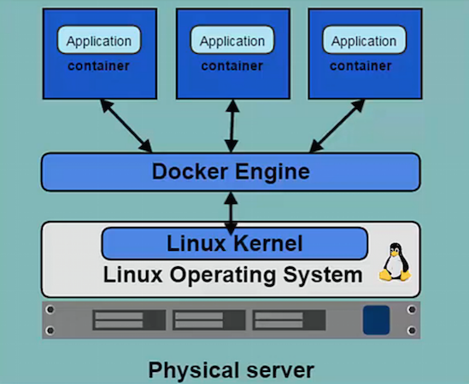
Docker & Linux Kernel
Docker Engine (deamon) is the program that enables containers to be built, shipped and run.

Slide 12
Docker Installation
Centos OS 7
sudo yum install -y yum-utils device-mapper-persistent-data lvm2
sudo yum-config-manager --add-repo \ https://download.docker.com/linux/centos/docker-ce.repo
sudo yum-config-manager --enable docker-ce-edge
sudo yum install docker-ce

Slide 13
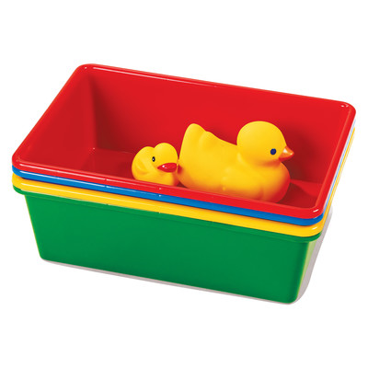
First Container

Slide 14
Hello World
In your Docker environment, just run the following command:
$ docker run busybox echo hello world
hello world
(If your Docker install is brand new, you will also see a few extra lines, corresponding to the download of the busybox image.)

Slide 15
Docker and Deamon
client / server architecture
Client takes user inputs and send them to the daemon
Daemon builds, runs, and distributes containers
Client and daemon can run on same or different hosts
#docker version

Slide 16
Images & Container
Images
Read only template used to create containers
Built by you or other Docker users
Stored in the Docker Hub or your local Registry
Containers
Isolated application platform
Contains everything needed to run your application
Based on images

Slide 17
Registry and Repository
Docker Hub
Own Registry
# docker images
# docker search
# docker pull images:<tag>

Slide 18
# docker run
$ docker run [options] [image] [command] [args]
$ docker run ubuntu:14.0 ps aux
-i connect to STDIN on the container
-t get psudeo-terminal
Command process ID 1

Slide 19
Container ID
# docker ps –a
# docker ps –qa
# docker ps –ql
#docker ps –l
Running deatached Mode:
-d deamon mode ( background )
# docker run –d ubuntu:latest ping 127.0.0.1 –c 50

Slide 20
PORT Mapping
-P
# docker run –d –P tomcat

Slide 21
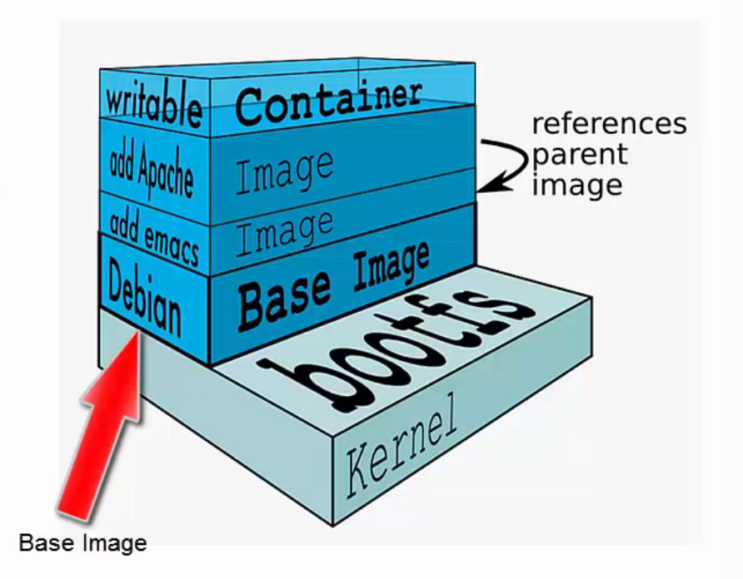
Building Images

Slide 22
Writable layer
Docker creates a top writable layer for containers
Parent images are read only
All changes are made at the writeable layer

Slide 23
Docker Commit
docker commit command saves changes in a container as a new image
#docker commit [options] [container ID] [repository:tag]
Repository name should be based on username/application
Can reference the container with container name instead of ID
# docker commit <id> lodelestra/vim:1.0
note default tag is latest

Slide 24
Dockerfile
A Dockerfile is a configuration file that contains instructions for building a Docker image
Provides a more effective way to build images compared to using docker commit
Easily fits into your continuous integration and deployment process

Slide 25
COMMAND
FROM
MAINTAINER
RUN
ADD
COPY
EXPOSE -→ -p
ENTRYPOINT -→ -e
VOLUME -→ -v

Slide 26
BUILD COMMAND
# docker build [options] [path]
# docker build –t [repository:tag] [path]

Slide 27
BUILD context
When you reference files inside instructions it must be file in your build context.
When building docker client will tar files from the context and send it to the docker daemon.
Thats also where docker will look for your Dockerfile. By default its the file named Dockerfile in the root of the context (for a different one use -f option)

Slide 28
Basic command
# docker ps -a
# docker stop <container_ID>
# docker start <container_ID>
# docker exec –it <container_ID> /bin/bash
# docker rm <container_ID>
# docker rmi <imagename> or [repot:tag]

Slide 29
Renaming taging images
# docker tag [image ID] [repo:tag] or
# docker tag [local repo:tag] [Docker Hub repo:tag]

Slide 30
DOCKER HUB REPOSITORIES
Users can create their own repositories on Docker Hub
Public and Private (one free)
Push local images to a repository

Slide 31
PUSHING IMAGES TO DOCKER HUB
# docker login
# docker pull <repo>
# docker push < repo:tag>
Local repo must have same name and tag as the Docker Hub repo

Slide 32
Volumes
Volume changes are excluded when updating an image
Persist when a container is deleted
Can be mapped to a host folder
Can be shared between containers
docker run -d -P -v testvolume:/myvolume nginx:1.9.4
docker run -i -t -v /data/src:/test/src nginx:1.9.4
ocker run -d -v "$(pwd)"/target:/app nginx
VOLUME /www/website1.com /www/website2.com
VOLUME ["myvol", "myvol2"]

Slide 33
Container Network
Bridge
Host
Overlay
Custom
-p <container port>
-p <host port>:<container Port>
-P expose all with host

Slide 34
Linking
Linking is a communication method between containers which allows them to securely transfer data from one to another
Source and recipient containers
Recipient containers have access to data on source containers
Links are established based on container names

Slide 35
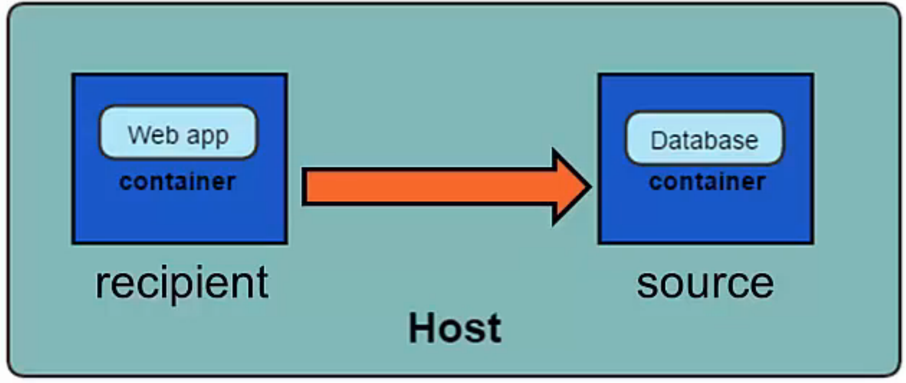

Slide 36
# docker run -d --name database postgres
# docker run -d -P --name website --link database:db nginx
"db" is an alias added in /etc/hosts

Slide 37
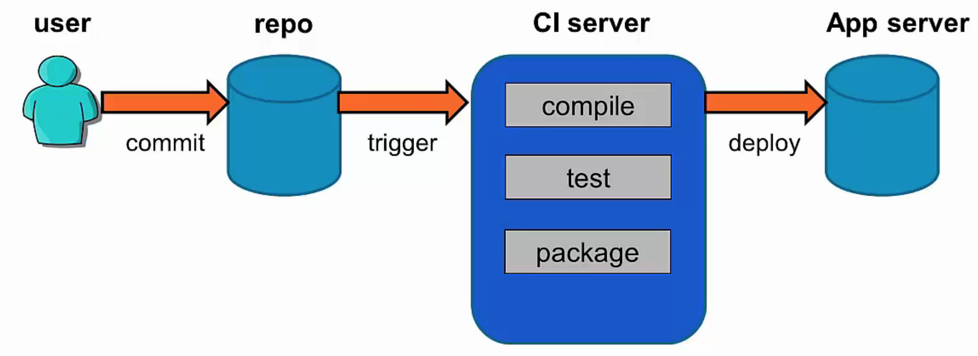
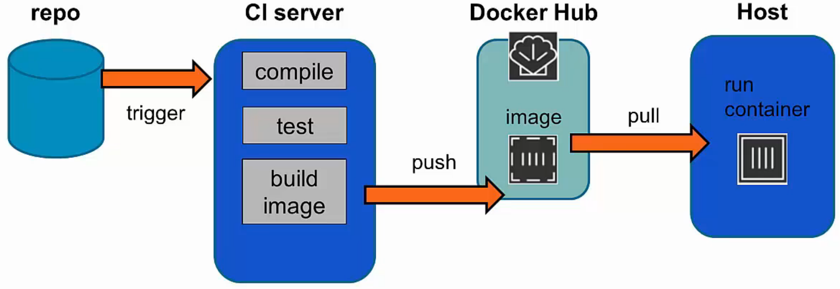
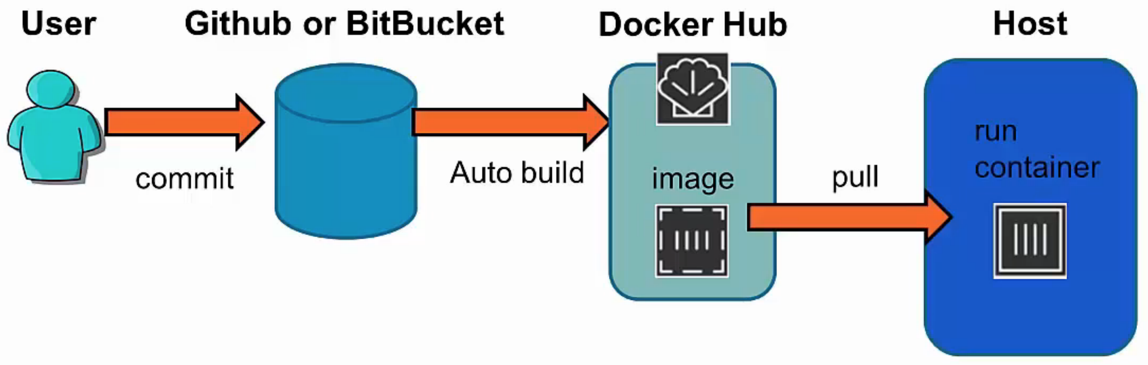
Docker in CI
traditional
Latest

Slide 38
Docker Compose
Docker Compose is a tool for creating and managing multi container applications
Containers are all defined in a single file called "docker-compose.yml”
Each container runs a particular component/service of your application. For example: Web front end / User authentification / Payments / Database
Container links are defined
Compose will spin up all your containers in a single command

Slide 39
Docker-compose.yml
version: '2'
services:
javaclient:
build: .
command: java HelloWorld
links: - redis
redis:
image: redis

Slide 41
Running docker-compose
# docker-compose up
# docker-compose run
# docker-compose down

